Slide 1
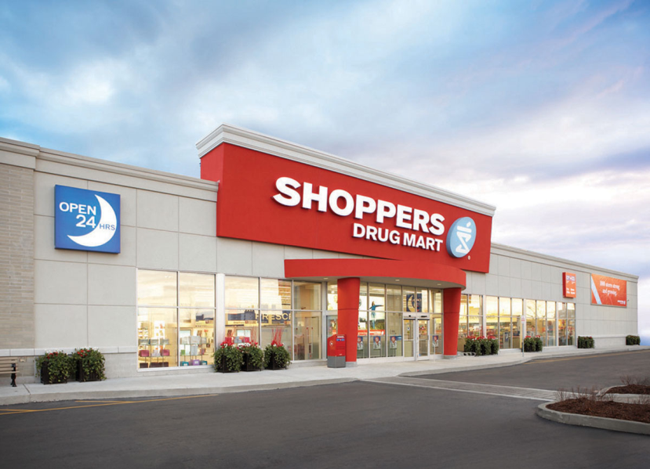

Digital Transformation in Pharmacy

Slide 2

AGENDA
TCS Digital Capabilities
Evaluation of Shopper’s Digital initiatives
Our Point of View for SDM’s
Customers
Pharmacists
Demo/ Solutions

Slide 3
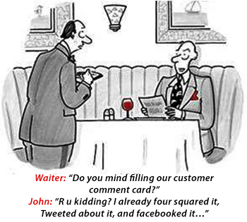
What is Driving the change?
CUSTOMER …
Connected
Aware
Demanding

Slide 4


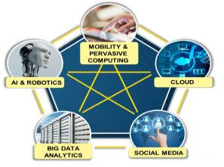
Digital Re-Imagination –New Growth Frontier
Leveraging emerging digital forces to reimagine
Business Processes
Business Models
Offerings
Customer Segments
Channels
Workplaces

Slide 5








Digital Capabilities - A Snapshot
Engagement Models
10,000+
Professionals
800+
Engagements
378+
Customers
Digital Re-Imagination for Business Functions – Functional Advisory & Solutioning
Co-Creation Unit for Continuous Innovation
Mobile App Factory set up
Voice of Customer Analysis
Architecture & Technology Transformation
Proof of Concepts
9
Delivery Centers
25+
Products
Investments
Key Customers
Customer Experience Center
Chennai
TCS CoIN
(Co-Innovation Network)
Customer Collaboration Lab
Santa Clara CA
Retail Products
Universal Commerce Engine
mobile POS
Store Power
Perivista TM
Personalization Engine
OptumeraTM
Hadoop Archival
Hy5 Suite – Develop, Test, Manage
Alliances & Partnership

Slide 6


TCS Digital Re-imagination Offering
Redefining Customer Experience
Defining Next-Gen customer User Journey
Designing In-store customer experience
Make me feel Special
Anytime Shopping
Give me more
choice
Help me find
Give me lowest Price
Deliver where I am
Intelligence Responsive Merchandizing
Enabling Real Time Pricing & Omni Channel Assortment
Digital enablement of Buyers and Merchants
Fun shopping
Offers for me
Digital Stores
Digitize the Store Operations and Workforce
Cross channel Hub enablement for Stores
Cross Channel Unified Supply Chain
Design of Flexible Fulfilment with focus on last mile to ensure same day delivery

Slide 7
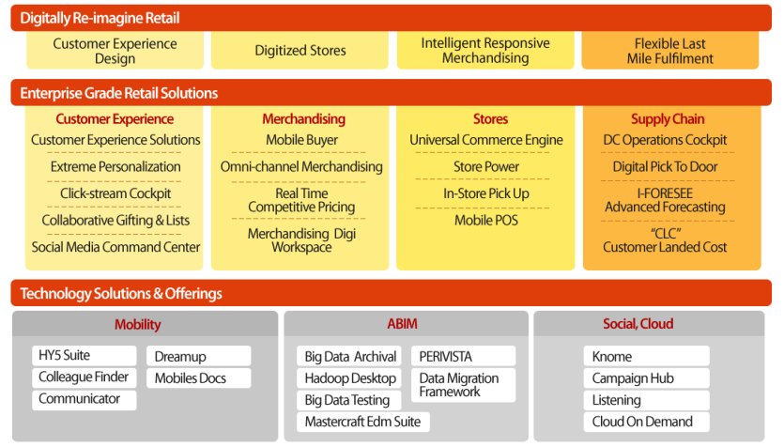
Digital Offering portfolio - Retail
1
2
Virtual Agent
Perivista Shopper
Mobile Patient engagement Platform
3
Notes:
Update for tomorrow

Slide 8
Digital Impact in Pharmacy: On the Rise
Online health self-education, online patient-doctor consultation is on the rise; Focus group Survey along with a Leading Pharmacy Retailer, US showed the following asks from customers:
Information and guidance on their Symptoms and health conditions
New/ Alternate drugs for chronic diseases
48% of smartphone owners used internet enabled phone to look up health and wellness information 79% of smartphone users and 68% of tablet users look up symptoms online
Physicians also research specific patient conditions online immediately before a patient consult, average of 3.4 times per week Mean weekly usages before, during and after a patient consult have increased year-over-year, suggesting that online medical resources are increasingly being incorporated into physicians’ daily work life
Regardless of whether they buy a product over the internet or in-store, consumers are influenced by online channels
Digital influence on Health care
… on the rise
Kantar Media Sources & Interactions Study, March 2013
2013 MARS Online Behaviour study
Notes:
Combine with the above slide…

Slide 9
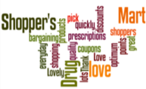
Voice of Customer – sharing experiences @SDM
Thank you shoppers for finally allowing coupons to be scanned by cell phone! Did it yesterday. Such an improvement, long overdue! Happy shopper here
I love Shopper's Drug Mart. They don’t just have my pills, have lots of everyday products, bunch of sales and promotions almost everyday, and I love racking up those optimum points!
Lovely and quality bargaining
Love shopping at Shopper's Drug Mart as it's so close to me and the staff members are always so friendly and helpful.
There is something for everyone there. The staff are always courteous and always willing to help you.
Makes me happy inside and out!!!!!
I wasn't feeling well and it was nice that I could get my prescription slip picked up, filled and delivered quickly. Have a terrific day and keep up the great service.
Top +ve
Why are stores not able to electronically check inventory at other stores? Had to go to three different locations to get imitrex today!
Let's not be advertising a bogo sale on "regular priced vitamins and supplements" and then find the ENTIRE SECTION on "sale"...Dirty:(
Terrible customer service :( not honoring coupons:( very dissatisfied
Love Shoppers but your emails are annoying.. and how about a REAL giveaway once in a while?
When are you going to get into the 21st century? You send out coupons by email and require that people PRINT them out to get the benefit. Seriously?
Your service is pretty slow. I lodged a complain few days ago and still no resolution. It has been delayed without a reason. Wasted my money and time shopping at your store.
Top
-ve
In-Store Customer Service, Coupons and Points : Make or Break relationships @Shoppers Drug Mart

Slide 10

SDM’s Everyday App vs. competition
In terms of Pharmacy features, SDM’s Everyday App has the capability to:
Refill Rx via scan
Rx/ Refill/ pickup reminders
Additional features:
Pill identifier
Rx Transfer
Prescription history
Family Rx refills
Regarding navigation and shoppability of the app, SDM allows shoppers to:
View Product list & info
View flyers & offers
Create Shopping List, QR scan
Additional features:
Search enabled filters
Search by voice
Add to cart
View ratings & reviews
Pharmacy Features
Navigation & Shoppability
SDM’s Everyday App has capability to add a preferred pharmacy and find nearby stores
Additional features:
Health Dashboards
Pharmacy chat option
Event finder
Insurance providers list
DUR checks
Value Adds

Slide 11

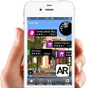

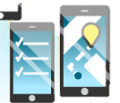
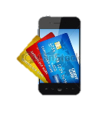

Customer journey – Re-Imagined for SDM
Your Rx is ready!
M-Wallet
At home
Store Visit
Entering the store
Inside the store
Jane gets an alert on her mobile that she is running out of meds
Weight of the pill box notifies pill level
She quickly places a refill order through her mobile app
Receives points to redeem in store;
The next day when Jane is out and about, on her holiday, she gets a message notifying that her Rx is ready for pickup.
Through the AR app on her mobile, she looks for nearest SDM store
As she enters the pharmacy, Jane is recognized in-store – though its not her regular store
Pharmacist is informed on his dashboard about Jane’s arrival.
The in-store mode of the app routes Jane to the vitamins section listed in her refill list.
As she approaches the pharmacist, he pulls up her profile on his smartphone device
He recommends the Flu-shot program for her kids – she instantly books appointment
Pharmacist suggest a new generic drug for her. She checks for drug interactions instantly on her smartphone
Jane picks up her meds, pays through m-wallet and gets her loyalty points credited
She returns home happy with the experience.
Enablers
IOT based Smart pill box
Digital SMS – Pre-Order
Refill alerts
Augmented Reality app
Personalized location based offers
iBeacon
Mobile app
Store Power
AR Promo Locator
Collect & go
In-Store App
Way finding
Scan for Info
Special item requests
Loyalty integration

Slide 12

Digitally Re-imagine the Customer interactions: To Be
Give me Convenience
Keep me Healthy
Enriching Customer service
Empathize with me
IOT based Smart pill box
Digital SMS – Pre-Order
Prescription ready alerts
Family prescription management
BOPIS/ mail order
E-Transfers across stores
One click appointments scheduling
Mobile Dosage reminders
Pill identifier & Symptom tracker on mobile
Health monitoring tools
Self diagnosis application
DUR checks
In-Store Self Help – Discover, Locate Products & Promotions
Avatar: Guide me, Answer my questions
Proactive Medication review
Personalization – ‘Offers for me’, reward for my loyalty
Social Forums & communities for specific conditions
In-store event alerts, reminders

Slide 13

Digitally Re-imagine the Pharmacist’s interactions: To Be
Medication Therapy Management
Patient well being
Improving efficiency
Predictive alerts on diseases – flu, allergy
Prescribable digital therapies
Tracking app
Ingestible/ Wearable sensor
Smartphone enabled personal health device
Sensors for diagnosis & monitoring
Pharmacy-to-Patient Services
Analytics for patient care gaps
Perivista –
In-store customer analytics
Sentiments, Profile, Behaviour, Associations
People network & Social influence
Delivers a pre-computed set of Analytical customer metrics
Predictive alerts on Inventory
Customer Kiosks/ ipad for entering demographic info
Store Power –
task management,
predictive operations,
holistic view of customer preferences & interactions
Cross channel order visibility

Slide 14
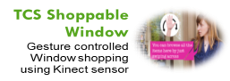
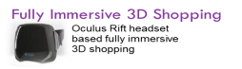




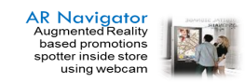


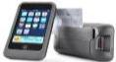
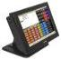
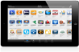

Retail Solutions
Creating additional channels
Digitally Re-Imagine Stores
Shop by Thinking
Provide a Shopping window triggered by thoughts
Interactive Displays
CuBuzz
Interactive Digital Content Proliferation tool
myHome IOT
Extending Interconnected Retail to Home
PerivistaTM
360^{O} view of Customer
TCS POS
Store Power
mPOS
OptumeraTM
TCS Rewardz TM
4th Generation POS
Anywhere Anytime Check out
Associate Empowerment with Mobility
Omni-Channel Merchandising Workbench
Personalization

Slide 15
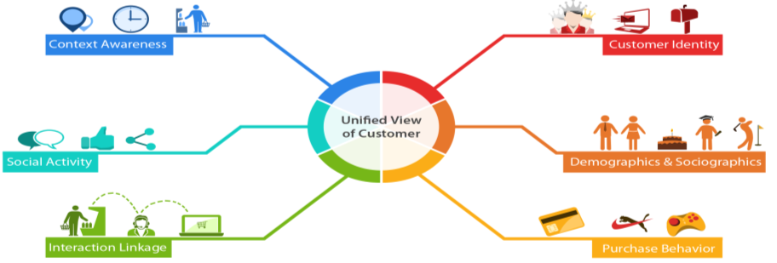
TCS PeriVista Shopper – Connecting the Retail customer across touchpoints
Parallelized Data ingestion
Cross-channel & Social identity resolution
Cross-channel Retail Customer datamodel
Entity, Event, Topic and Sentiment extraction
Customer Attribution & Analytics
Built for multiple workloads
Set of Big data based TCS tools for accelerating the Retail Consumer insights

Slide 16
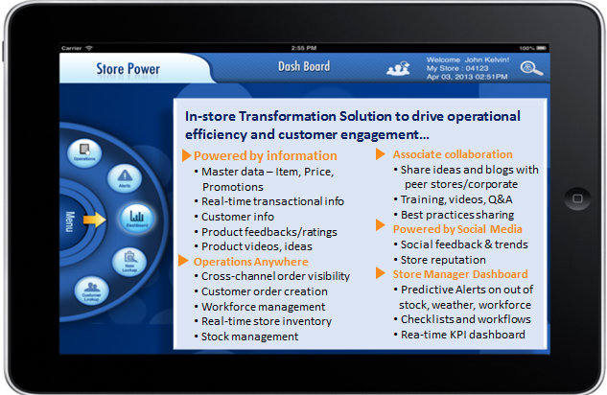
Store Power – Solution Overview

